Slide 1
Section 3.1
Graphing Polynomial Functions
© Copyright all rights reserved to Homework depot: www.BCMath.ca

Slide 2
Polynomial Functions
A polynomial function is a function such as a line, quadratic, a cubic, a quartic and so on. All the exponents of “x” are positive integers
General Form:
Factored Form:
(Quadratic)
(Cubic)
Quartic
In this section, we will look at how to interpret polynomial equations in general form and factored form

Slide 3
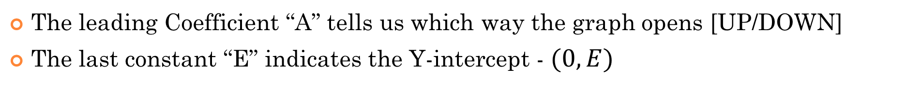
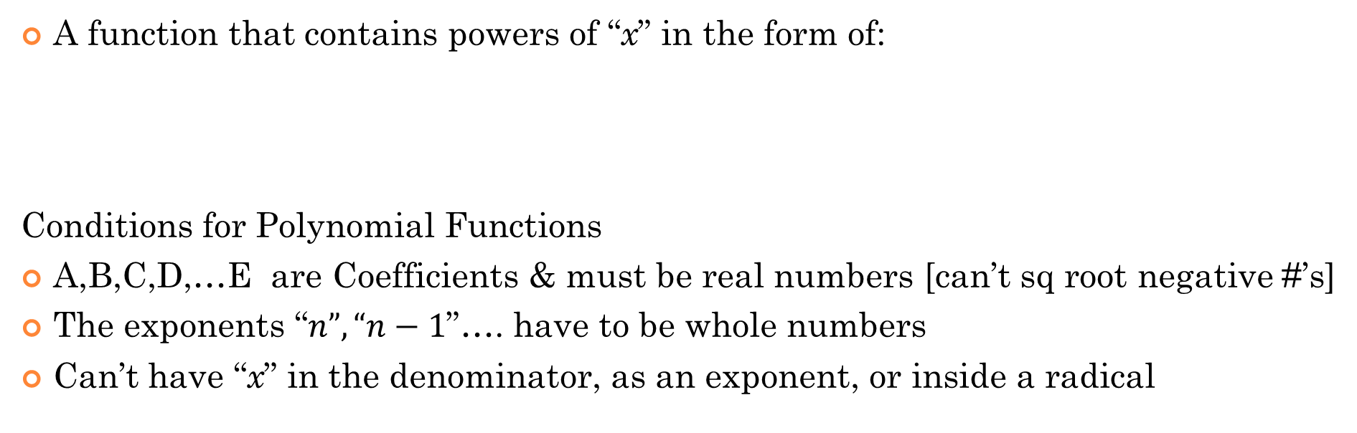
What is a Polynomial Function?
A function that contains powers of “x” in the form of:
Conditions for Polynomial Functions
A,B,C,D,…E are Coefficients & must be real numbers [can’t sq root negative #’s]
The exponents “$n”, “n−1$”…. have to be whole numbers
Can’t have “x” in the denominator, as an exponent, or inside a radical
The leading Coefficient “A” tells us which way the graph opens [UP/DOWN]
The last constant “E” indicates the Y-intercept - $(0,E)$

Slide 4

Ex#) Indicate which of the following are NOT polynomials & explain why:
YES
YES
$$yes, \left|x2\right|=x2$$
NO, can’t root the variable
NO, this is a rational function
Yes, b/c a constant can be a polynomial with a dress of zero
b/c ‘x’ is in denominator
NO, b/c abs value fc are not polynomials
NO, b/c “x” is in exponent

Slide 5
Common Terms for Polynomial:
Degree of a Polynomial:
The largest exponent for the variable
The degree can be used to determine how many times a polynomial function changes directions [Number of turns going up/down]
Leading Coefficient:
The coefficient of the term with the largest exponent
The leading coefficient can be used to determine where the graph begins on the left side – (top/bottom)
Negative (vertical reflection)

Slide 6
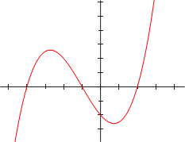
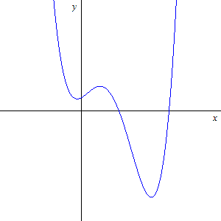
Definition & Terms
The degree of a polynomial is the largest exponent of a variable in the polynomial
  The degree indicates the “maximum” number of roots [x-intercepts] a polynomial can have and how many times the graph changes directions
Degree:
3
Degree:
4
Degree:
2
Cubic function
Quartic function
Quadratic function
LC: 2
LC: 5
LC: 8
Constant: -2
Constant: 4
Constant: 8
Y-int: (0,-2)
Y-int: (0,4)
Y-int: (0,8)
Leading coefficient: the coefficient of the term with the largest degree
  Leading Coeff (+): Graph opens up, (–’ve): Graph opens down, or flipped upside down
Constant Term: Term with no variables [Y-intercept]

Slide 7
General Concepts:
EVEN Degree functions
opens up
(the left side is at the TOP)
ODD Degree functions usually begin at the left side from the bottom
If the leading coefficient is NEGATIVE, the graph will have a vertical reflection
(Up side down)
Where the graph starts on the left side will then be reversed!

Slide 8
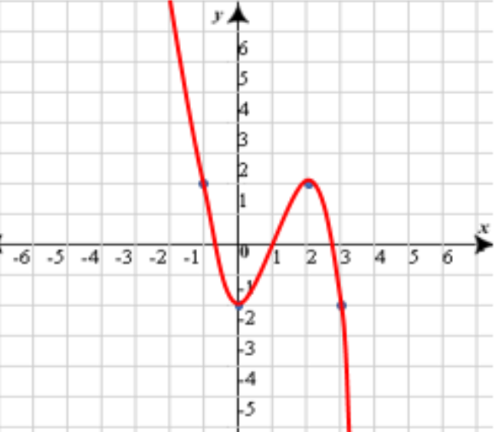
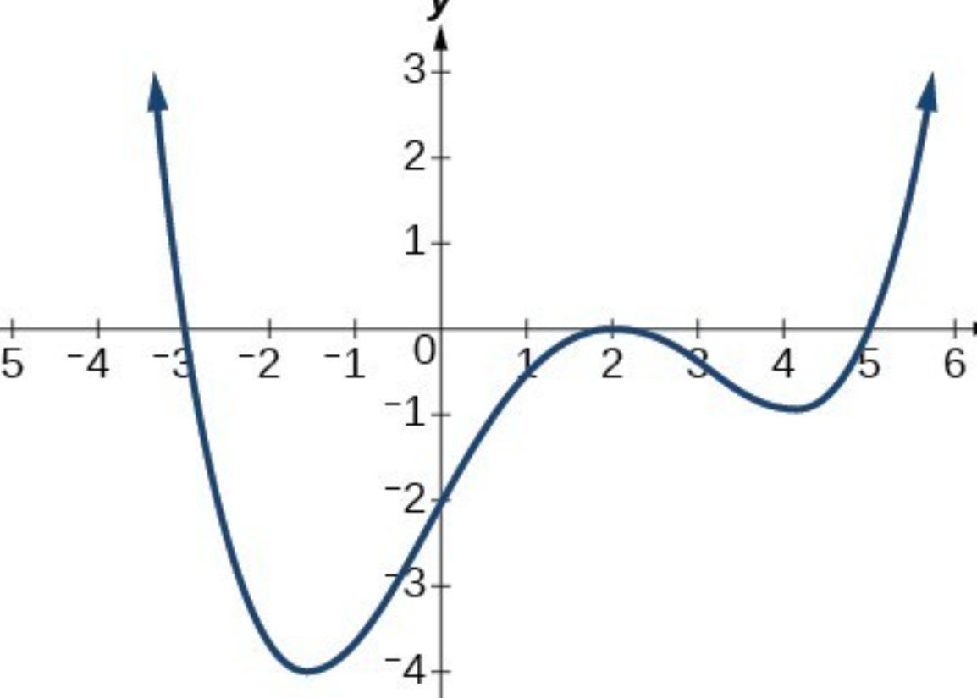
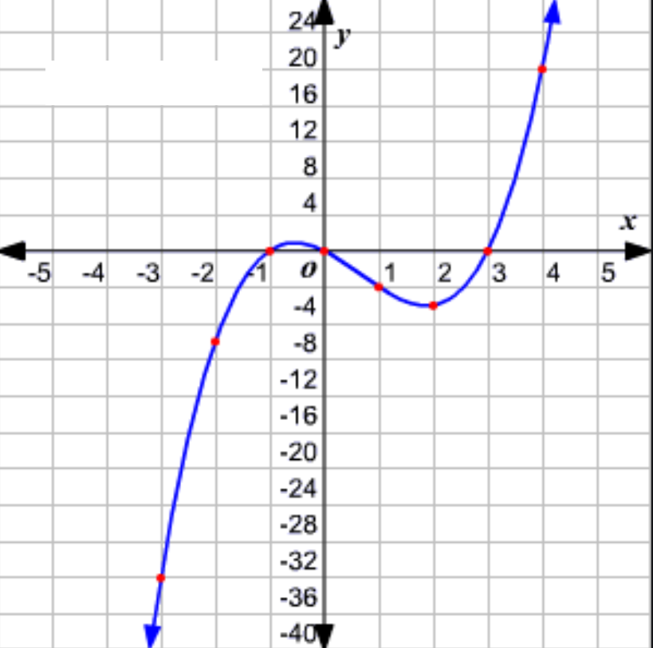
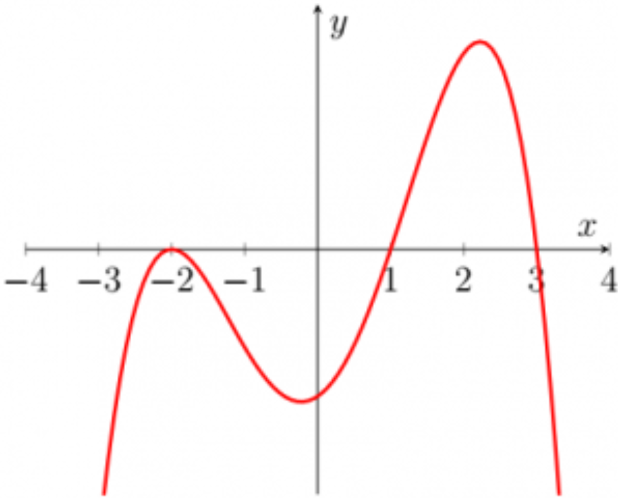
Ex: Indicate the degree, LC, constant term for each function below. Then state what function it is (ie: Cubic, quartic,….) and match it with the corresponding graph below

Slide 9
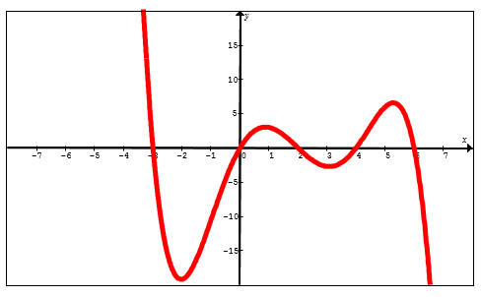
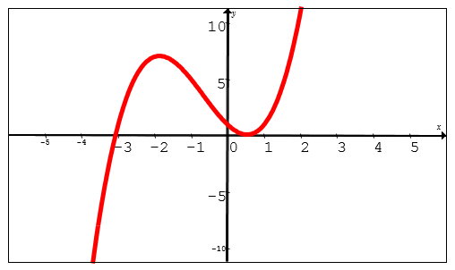
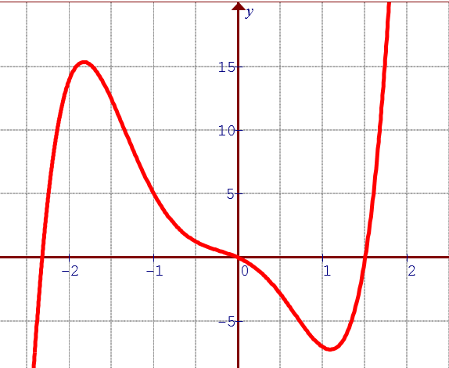
Ex: Match the graph with the correct function:

Slide 10
Reading a Function in Factored Form:
A polynomial function in General form:
A polynomial function in Factored Form:

Slide 11
Ex: Find the Leading Coefficient, degree, y-intercept, and x-intercepts for each of the following

Slide 12
Graphing a polynomial function in factored form:
Find the roots (x-intercept) and look for repeated roots
Find the Y-intercept: where the graph crosses the y-axis
Find the Degree: Count the number of X’s in the function OR get the exponents of “X’s”
Find the lead coefficient: tells you which way the graph opens
When 2 roots are the same, it’s called a “Double Root”.
Instead of crossing the x-axis, it “bounces” off the x-axis.
When 3 roots are the same, it’s called a “Triple Root”
A triple root will bounce at the x-axis twice

Slide 13
What happens with Repeated Roots:
When a root is repeated, it will “bounce” off the x-axis
The number of bounces equals how many times it is repeated minus one
y
8
6
4
2
0
x
-5
-4
-3
-2
-1
0
1
2
-2
-4
-6
-8

Slide 14
Ex: Indicate the number of roots, the value of the roots, the degree, and leading coefficient for each of the following. Then graph each function separately:

Slide 15
Ex: Given the equation:
Graph and find the following
y
y
6
6
4
4
2
2
x
x
-4
-4
-3
-3
-2
-2
-1
-1
0
0
1
1
2
2
3
3
4
4
-2
-2
-4
-4
-6
-6

Slide 16
Ex: Given the equation:
Find the following:

Slide 17
Ex: Given the equation:
Graph and find the following
y
y
4
4
2
2
x
x
-3.5
-3
-2.5
-2
-1.5
-1
-0.5
0
0.5
1
1.5
2
2.5
3
3.5
-3.5
-3
-2.5
-2
-1.5
-1
-0.5
0
0.5
1
1.5
2
2.5
3
3.5
-2
-2
-4
-4

Slide 18
Ex: Given the equation:
Graph and find the following
y
x
-2
-1
0
1
-5
-10
-15

Slide 19
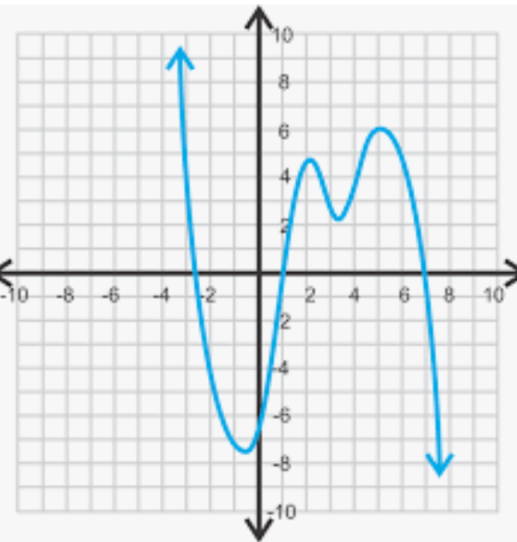
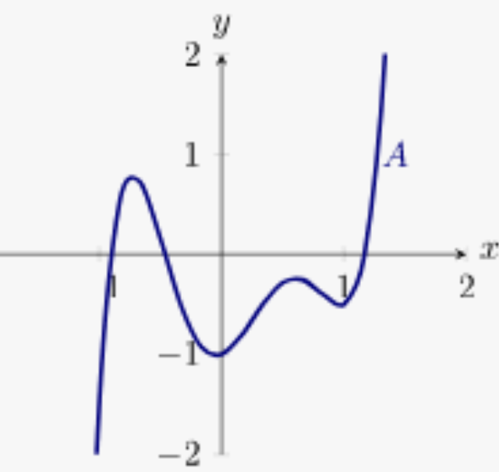
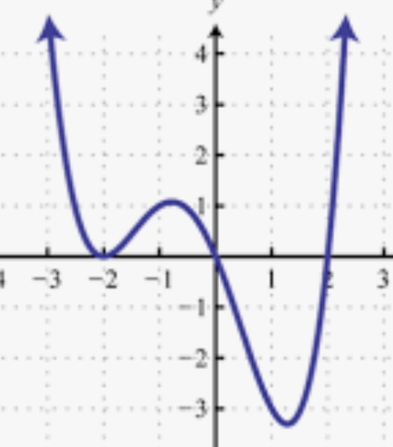
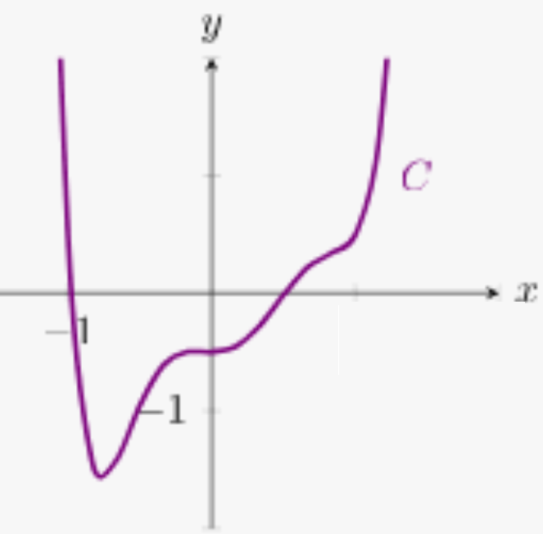
Match each graph with the corresponding Equation:

Slide 20
Ex: Determine the equation of a function with roots: -1, 1, 3 and y-intercept of -6.
Plug the roots into the equation in factored form
Plug the coordinates of the point into the equation to solve for “a”

Slide 21
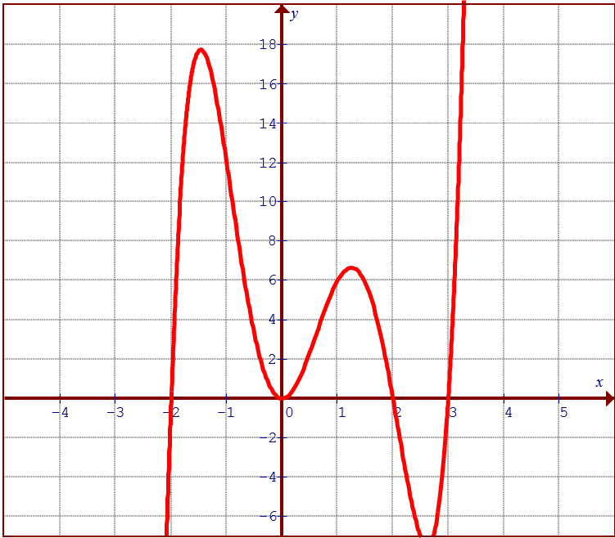
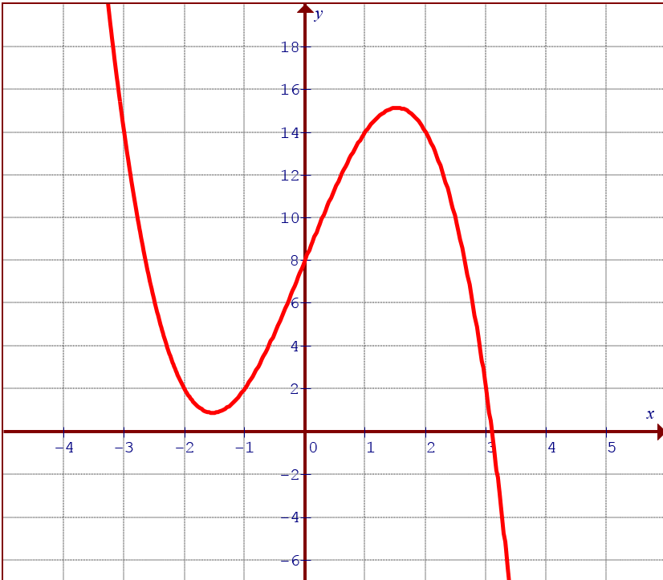
Practice: Derive the Equation for each polynomial

